Slide 1
CUSTOMER RELATIONSHIP MANAGEMENT
CONCEPTS AND TECHNOLOGIES
Chapter 9
Managing the customer life-cycle:
customer retention and development

Slide 2
3 stages of the customer lifecycle
Customer acquisition
Customer retention
  aims to keep a high proportion of current customers by reducing customer defections
Customer development
  aims to increase the value of those retained customers to the company

Slide 3
Contents of a customer retention plan
Which customers should be targeted for retention?
What customer retention objectives should be set?
What customer retention strategies will be used?
How will the performance of the retention plan be measured?

Slide 4
Simple customer retention definition
Customer retention is the number of customers doing business with a firm at the end of a financial year expressed as percentage of those who were active customers at the beginning of the year.

Slide 5
The appropriate time frame
Depends on re-purchase cycle found in the industry.
  Insurance policies are renewed annually
  If the normal replacement cycle is four years, then retention rate is more meaningful if it is measured over four years instead of twelve months

Slide 6
Can you tell if a customer has defected?
May not be able to measure retention and defection if you have
  Product-based views of customers
  Channel-based views of customers
  Separate customer records in sales, marketing and service

Slide 7
Three measures of customer retention
Raw customer retention rate.
  the number of customers doing business with a firm at the end of a trading period expressed as percentage of those who were active customers at the beginning of the period.
Sales-adjusted retention rate.
  the value of sales achieved from the retained customers expressed as a percentage of the sales achieved from all customers who were active at the beginning of the period.
Profit-adjusted retention rate.
  the profit earned from the retained customers expressed as a percentage of the profit earned from all customers who were active at the beginning of the period.

Slide 8
Retention issues
Retention measures should be made with an understanding of customer profitability issues
The fundamental purpose of focussing CRM efforts on customer retention is to ensure that the company maintains relationships with strategically significant customers.
It may not be beneficial to maintain relationships with all customers. Some are
  too costly to serve
  strategic switchers constantly in search of a better deal
  not strategically significant in roles such as benchmark, door opener, inspiration or technology partner

Slide 9
Customer retention vs. value retention
Companies should focus on retaining customers that contribute value.
Sometimes this will mean that the focus is not on retention of customers, per se, but on retention of share of wallet.
  In the banking industry, for example, it may be more important for companies to focus on managing the overall downward migration of customer spending than customer retention. Many customers simply change their buying behavior rather than defect.

Slide 10
The economic argument for customer retention
Purchases grow as tenure grows
Customer management costs fall over time
Customer referrals grow
Premium prices
  Customers who are satisfied in their relationship may reward their suppliers by paying higher prices.

Slide 11
Which customers to retain?
Strategically significant customers
  High life-time value customers
  High volume customers
  Benchmarks
  Inspirations
  Door openers
But… these may also be attractive to your competitors

Slide 12
Commitment and retention
The level of commitment between your customer and you will figure in the decision about which customers to retain.
  If the customer is highly committed, i.e. impervious to the appeals of competitors, you do not need to invest so much in retention.
  If strategically significant customers are not committed to you, you may want to invest considerable sums in their retention

Slide 13
Why focus on newly acquired customers?
New customers may have greater future life-time value potential than longer tenure customers.
  evidence suggests that retention rates rise over time, so if defections can be prevented in the early stages of a relationship, there will be a pay-off in future revenue streams

Slide 14


Two basic strategies for customer retention

Slide 15
Negative and positive customer retention strategies
Create exit barriers
Enforce the contract
Extract switching penalties
Delight customers
Create customer-perceived added value
Create social and structural bonds
Create customer engagement

Slide 16
What is customer delight?
Customer delight = P > E
where
P = Perception
E = Expectation.

Slide 17
What do customers really expect?
1. Expectations based on promises
“I expect to have my car serviced within 2 days of calling the garage”
2. Expectations based on desires
“I want my car serviced the day I call the garage”
3. Expectations based on experience
“Most folks normally have to wait 3 days to have their car serviced”
4. Expectations based on ideals
“My car should be serviced overnight and delivered to my home the next morning”

Slide 18
Bridging the gaps: importance against performance
Clean toilets
5.5
Importance
OFI
2.5
Performance
6.5
Importance
Food quality
OFI
4.5
Performance
Numbers are scores
on a 7-point scale
OFI
= opportunity for improvement

Slide 19
Customer delight through product quality
Customer delight
Attractive qualities
(unexpected attributes)
Linear qualities
(wanted attributes)
Exceptional
Basic qualities
(expected attributes)
LOW
HIGH
Level of achievement
Missing
Inadequate
Customer dissatisfaction

Slide 20
Simple ways to delight customers
provide information about the customer’s served market.
  A packaging company could alert a fast-moving consumer goods manufacturer customer to competitive initiatives in the market.
volunteer to collect and replace a faulty product from a customer rather than issuing a credit note
offer better, lower cost solutions to the customer, even though that might reduce margin

Slide 21
3 ways to create customer-perceived added value
loyalty schemes
customer clubs
sales promotions.

Slide 22
Loyalty program definition
A loyalty program is a scheme that offers delayed or immediate incremental rewards to customers for their cumulative patronage.

Slide 23
Reward programs
Co-op dividend > Green Shield Stamps
> American Airlines AAdvantage Card > Nectar
Card-based schemes have changed over time
  No identification – member’s name
  Magnetic strip – chip-embedded
  Solus – networked
  Company-operated – third-party operated
  Trivial reward – major reward (5%)

Slide 24
The Tesco Clubcard
Tesco introduced its first loyalty program in 1995, called the ‘Clubcard’
  Enabled customers to accumulate points with each purchase that could be used to obtain discounts off future purchases.
The ‘Clubcard’ proved to be very successful.
  First, in attracting more customers to Tesco stores.
  Second, in capturing valuable information from customers with every swipe of the card, which led to the creation of a powerful database
As a result of this initial success, 108 customer segments were identified and specific offers were made to each
  high-value customers receive valet parking when they come to shop and other special privileges.
In 1996 Tesco introduced two further loyalty cards
  a student card and a card for mothers, with offers specifically targeted to each group’s needs.

Slide 25
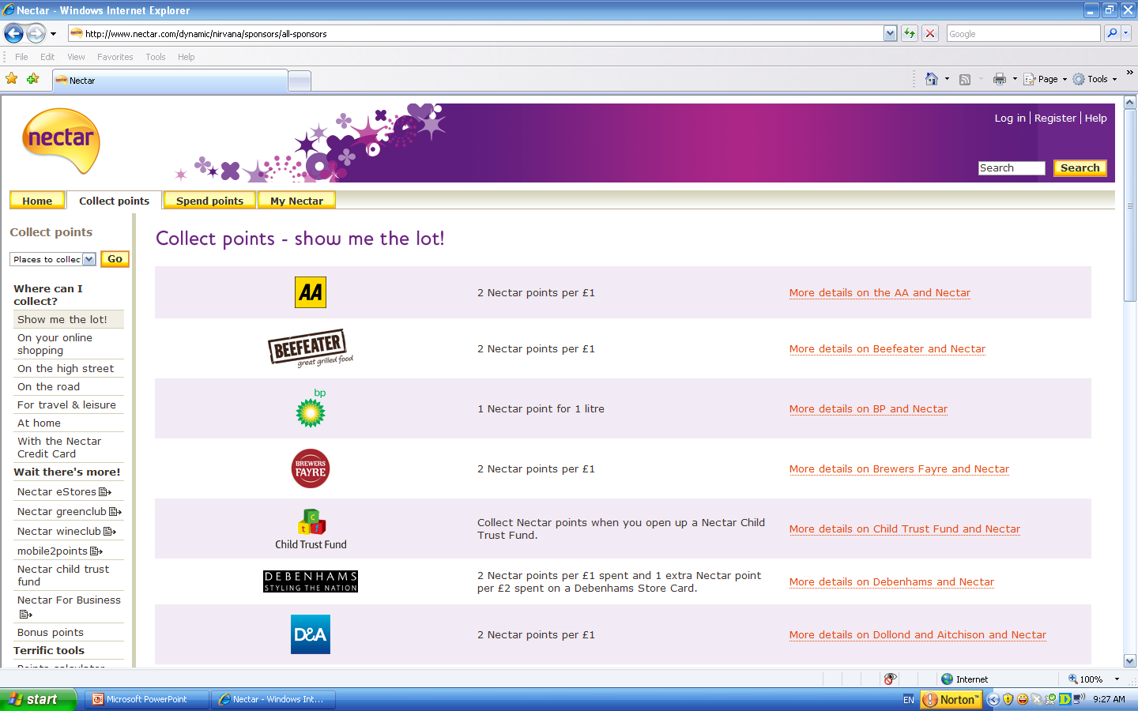
Nectar loyalty program

Slide 26
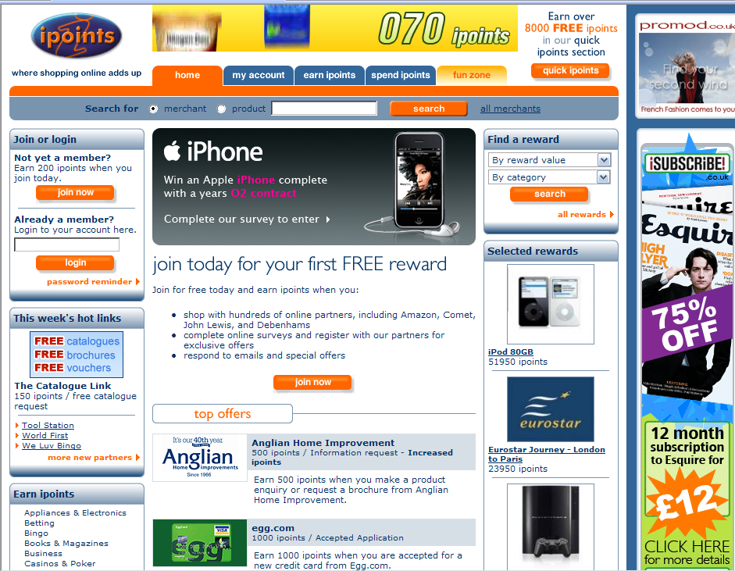
iPoints

Slide 27
Customer club definition
A customer club is a company-run membership organisation that offers a range of value-adding benefits exclusively to members.

Slide 28
B2C customer clubs
Swatch the Club (see www.swatch.com )
The Pampers Parenting Institute (see http://us.pampers.com/en_US/ppi.do)
The Harley Owners Group (HOG) (see http://www.harley-davidson.com/wcm/Content/Pages/HOG/hog_selector.jsp?locale=en_US)
The Volkswagen Club (see http://www.vw-club.de/)

Slide 29
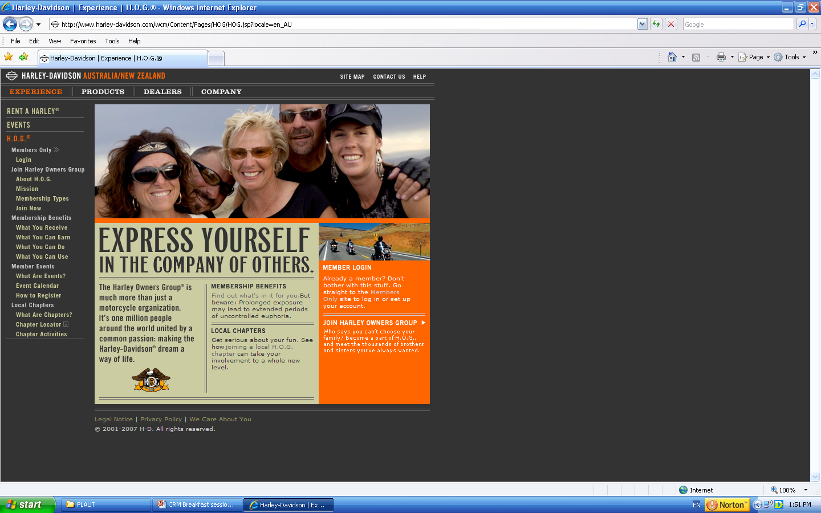
Harley Owners Group

Slide 30
Sales promotions that build repeat purchase
In pack or on-pack voucher
Rebate or cash-back
Patronage awards
Free premium for continuous purchase
Collection schemes
Self-liquidating premium

Slide 31
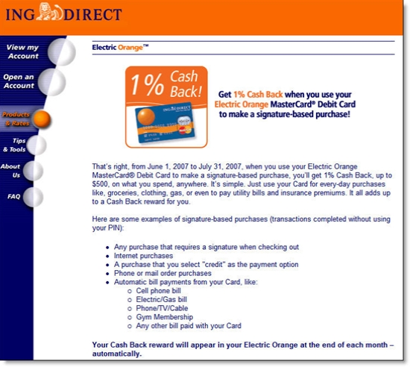
Cash-back sales promotion

Slide 32
Bonds
Social
  Positive relationships between individuals
    Empathy
    Responsiveness
    Reliability
  Leads to development of trust and commitment
Structural
  Investments linking customer and supplier
    Financial
    Legal
    Equity
    Technological
    Value-based
    Geographic
    Project
    Multi-product

Slide 33
Insurers encourage loyalty with financial bonds
Excellent claims service
No claims discounts
Tenure-related discounts
Multi-policy discounts
Financial Bonds

Slide 34
Adaptations serve as structural bonds
Adaptations are investments that one party makes to satisfy the expectations/demands of the other. There are 2 types of adaptation
  Unilateral reflecting power asymmetry
    “If Woolworths says they want daily deliveries of dairy product that’s what we do”
  Bilateral reflecting mutual efforts to build trust and demonstrate commitment
    “Intel works with Microsoft (the so-called Wintel alliance). MS builds software to run on Intel chips. Intel adapts its R&D and manufacturing processes to suit MS’s requirements.”

Slide 35
Suppliers are more likely to adapt
If buyer power is high
If customers are also adapting (reciprocity)
If supply-side managers are inclined towards relationship marketing
If customer-side managers are inclined towards partnership sourcing

Slide 36
Three forms of commitment
Instrumental
  customers are convinced that no other offer or company could do a better job of meeting their needs.
Relational
  customer develops an emotional tie may be with an individual person, a work group or the generalised company as a whole
Values-based
  customers’ values are aligned with those of the company

Slide 37
Values definition
Values are core beliefs that transcend context and serve to organise and direct attitudes and behaviours

Slide 38
Values-based commitment
Body Shop International
John Lewis Partnership
Harley Davidson
Co-operative Bank
Virgin Group

Slide 39
Context makes a difference to customer retention strategies
Number of competitors
Corporate culture
Channel configuration
Purchasing practices
Ownership expectations
Ethical concerns

Slide 40
KPIs for customer retention programs
Raw customer retention rate.
Raw customer retention rate in each customer segment.
Sales-adjusted retention rate.
Sales-adjusted retention rate in each customer segment.
Profit-adjusted retention rate.
Profit-adjusted retention rate in each customer segment.
Cost of customer retention
Share of wallet of the retained customers
Customer churn rate per product category, sales region or channel.
Cost-effectiveness of customer retention tactics.

Slide 41
The role of research
Why are customers churning?
Are there any lead indicators of impending defection?
What can be done to address the root causes?

Slide 42
Advance indicators of intention to churn
Reduced RFM scores (Recency – Frequency – Monetary value)
Non-response to a carefully targeted offer
Reduced levels of customer satisfaction
Dissatisfaction with complaint handling
Reduced share of customer (e.g. customer only flies one leg of an international flight on your airline)
Inbound calls for technical or product-related information
Late payment of an invoice
Querying an invoice
Customer touch points are changed e.g. store closes, change of website address
Customer change of address

Slide 43
Two main strategies for customer development
Cross-selling is selling additional products and services to an existing customer.
Up-selling is selling higher priced or higher margin products and services to an existing customer.

Slide 44
CRM technologies used for customer development
Campaign management
Event-based marketing
Data mining
Customization
Channel integration
Integrated customer communications
Marketing optimization

Slide 45
Strategies for terminating customers
Raise prices
Un-bundle the offer
Respecify the product
Reorganise sales, marketing and service departments
Introduce ABC class service

Slide 46
A typology of companies’ termination behaviours
Hardliners
  take an active and rigorous stance in terminating unprofitable relationships, including the regular clearance of their customer portfolio.
Appeasers
  take a more cautious approach concerning the termination of unprofitable relationships
The undecided
  are reluctant to terminate unprofitable relationships

